Slide 1
Open House November 5, 2019

Slide 2
You may have questions, and we have answers!
Immediately following the formal presentation, join us in the Commons for table discussions on topics presented tonight. Interact with P-TECH students, parents and staff to gain added insight.

Slide 3
Who We Are
Pathways in Technology (P-TECH) – Health Sciences at Hightower HS blends high school and college coursework with industry experience which allows students to earn their Associates of Applied Science degree (up to 60 college credit hours) and industry certifications at no cost to the student or his/her family.
Notes:
The Early College High School Initiative was founded by the Bill and Melinda Gates Foundation with a goal of providing access to college level coursework to students while still in high school. Through a secure partnership with Houston Community College, Fort Bend ISD is honored to provide its students the unique opportunity to earn up to 60 college credit or an Associate Degree at no cost to its students or their families.
Segue into degree options

Slide 4
How We Work
Pre-AP/AP and Dual Credit Courses | rigorous instruction, increase college readiness
AVID | provide academic and social support services
TSIA Preparation and Participation | reduce barriers to college access, increase college readiness, academic support
Summer Bridge Program | reduce barriers to college access, increase college readiness, and provide academic and social support services
Accommodations and Modifications: High School vs. College | provide academic and social support services
Extracurricular Involvement | develop the whole student
Notes:
To make the Associate degree options a reality, this is how we work at ECHS. We create an academic experience that is both robust and supportive to steer our students toward college readiness and completion.
Segue into Why Choose Early College. Announce: you will now the have the opportunity to hear about The Early College Experience from ECHS students Evyn Stewart and Chloe Parker.

Slide 5
Degree Option 1: Associate of Applied Science – Health Information Technology
Dr. Carla Tyson-Howard
HCC Department Chair – Health Information Technology

Slide 6
Health Information Technology

Slide 7
Career One Stop
https://www.careeronestop.org/videos/careeronestop-videos.aspx?videocode=29207100

Slide 8
Converting from Paper based records to . . .

Slide 9
. . . Electronic Health Records

Slide 10
Goal of HIM
Provide health information to authorized users in a timely fashion thus assuring the rendering of quality health care.

Slide 11
AHIMA Credentials
RHIA
RHIT
CCA
CCS
CCS-P
CHDA
CHPS
CDIP
CHTS
CPHI
Notes:
AHIMA offers 10 credentials. We will cover each one of these and their eligibility requirements on the next slides.

Slide 12
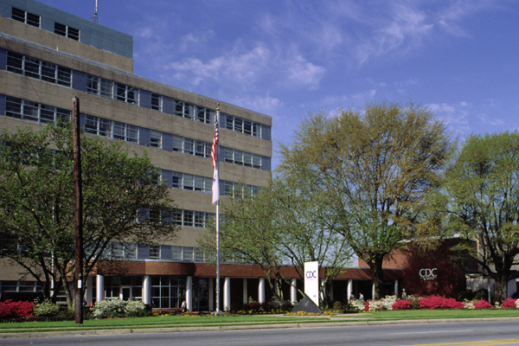
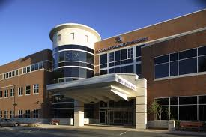
Where do they work?

Slide 13
Hospitals

Slide 14
Outpatient Clinics Hospice Alternative Care Sights
Notes:
Local, state, and national resource allocation is another use for cancer data. Examples of this include new locations for radiation therapy centers or new cancer screening programs.

Slide 15
Insurance companies Government agencies

Slide 16
Career Opportunities
Hospitals and Health Care Facilities
Software Vendors
Government Agencies
Pharmaceutical Companies
Outsourcing or Contract services

Slide 17
What are the job activities?
Record maintenance
Release of Information

Slide 18
Data Analysis
Research & Statistics
Coding
EHR

Slide 19
Quality Analysis & Improvement

Slide 21
Education for Health Information Management Professionals
Analyst Certificate
Coding Certificate
AAS degree
BS degree (TSU, Texas State University)
MS degree (University of Texas)
Doctorate degree (University of Texas)

Slide 22
Curriculum
3 levels of completion
Health Information Analyst
Coder (CCA)
AAS degree (RHIT)

Slide 23
Course Format
Distance Education (online)
Hybrid
Clinicals (practical experience)

Slide 24
Curriculum
Academic and Pre-requisites
ENGL 1301 English Comp I
BIOL 2301/2101, 2302/2102 A&P 1&2
POFI 1301 Computer Apps I
Social Science elective
Humanities elective

Slide 25
We look forward to serving You

Slide 26
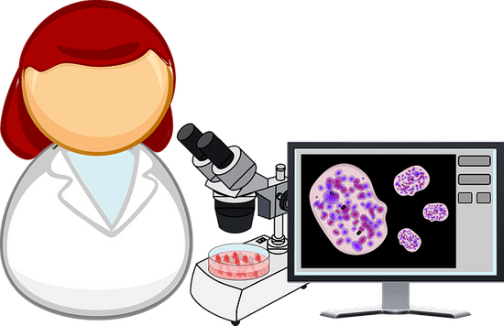
Degree Option 2: Associate of Applied Science – Histologic Technician
Dr. Min He
HCC Department Chair – Histological Technician

Slide 27
Histologic Technician Program

Slide 28
Houston Community College Histologic technician program
Min He, HTL (ASCP), M. D.
Professor,
educational coordinator

Slide 29
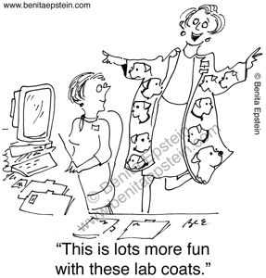
Welcome to histotechnology world

Slide 30
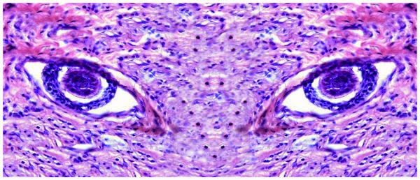
What do we do?

Slide 31
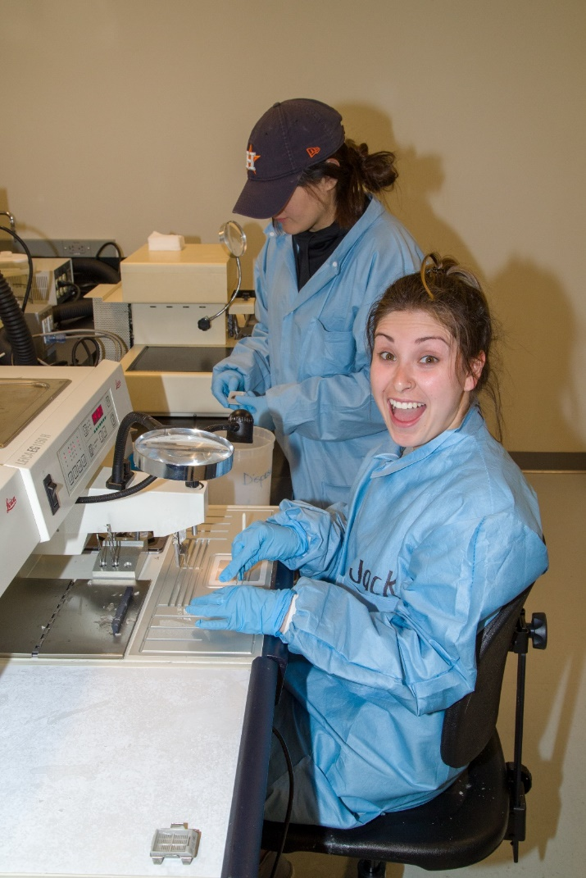
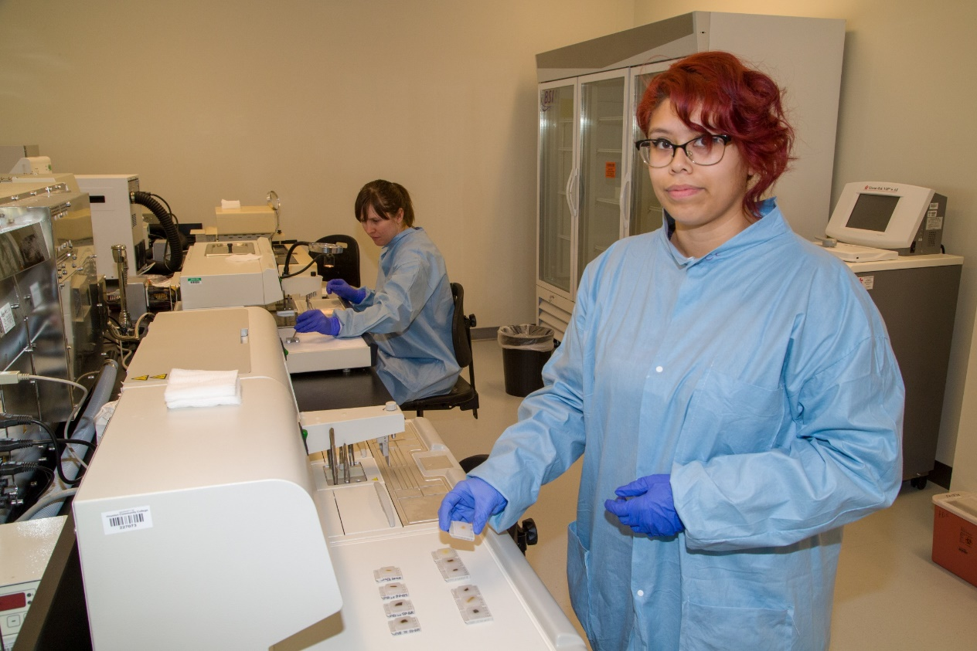
Student lab

Slide 32
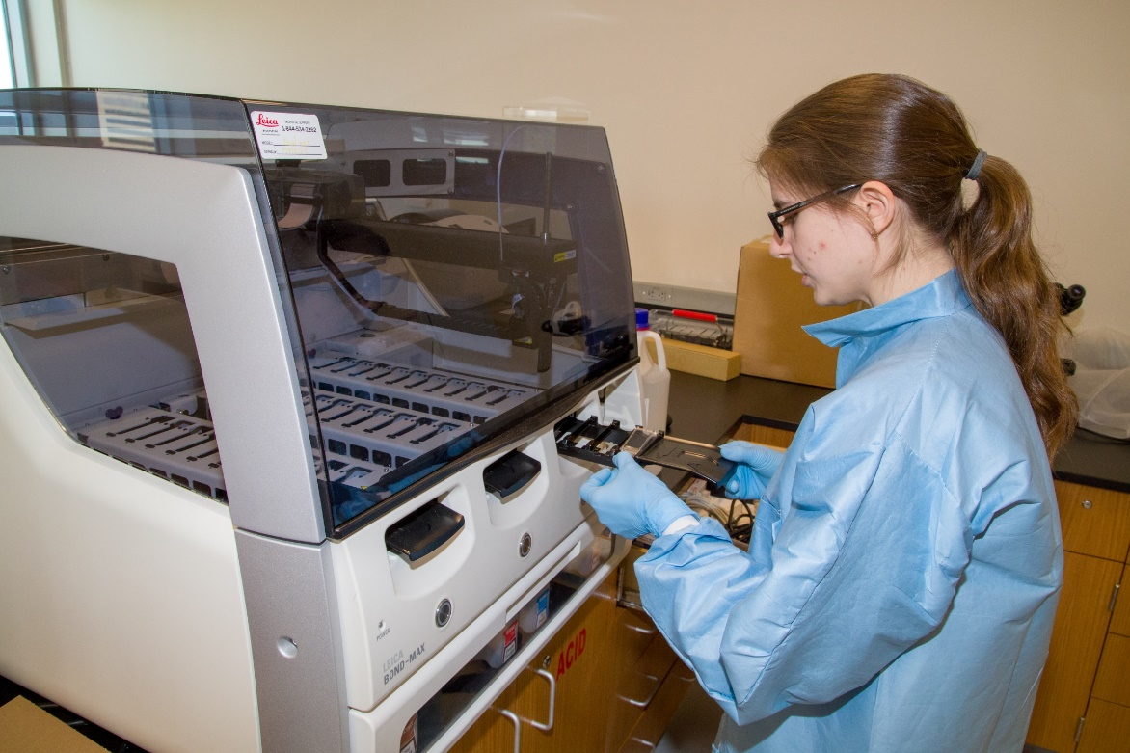
Student lab

Slide 33
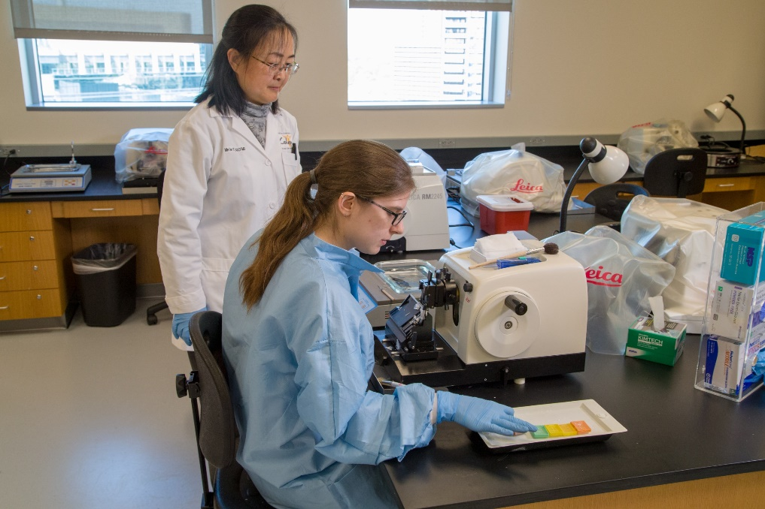
Student lab

Slide 34
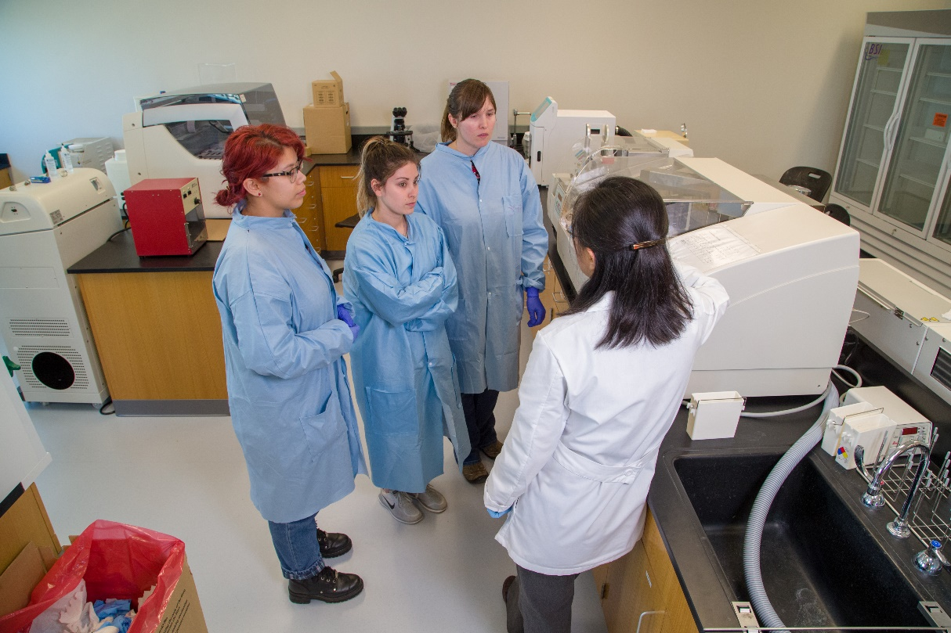
Student lab

Slide 35
Clincal sites
Baylor College of Medicine
Brown & Associates
Ben Taub
Clear Lake Hospital
Kingwood
LBJ Hospital (near ship channel)
Methodist
Medical Examiner’s Office
Memorial Herman
North Cypress Medical center
St. Lukes
Texas Children’s Hospital
UTMB in Galveston
UTH-department of pathology
……

Slide 36
Curriculum prerequisites
Prefix | Number | Course Name | Weekly Lec Hrs. | Weekly Lab Hrs. | Contact Hrs. | Credit Hours
HPRS | 1201 | Introduction to Health Professions | 2 | 1 | 48 | 2
MATH | 1314 | College Algebra | 3 | 0 | 48 | 3
ENGL | 1301 | Composition I | 3 | 0 | 48 | 3
BIOL | 1406 | General Biology I | 3 | 3 | 96 | 4
 |  | Prerequisite Total | 11 | 4 | 240 | 12

Slide 37
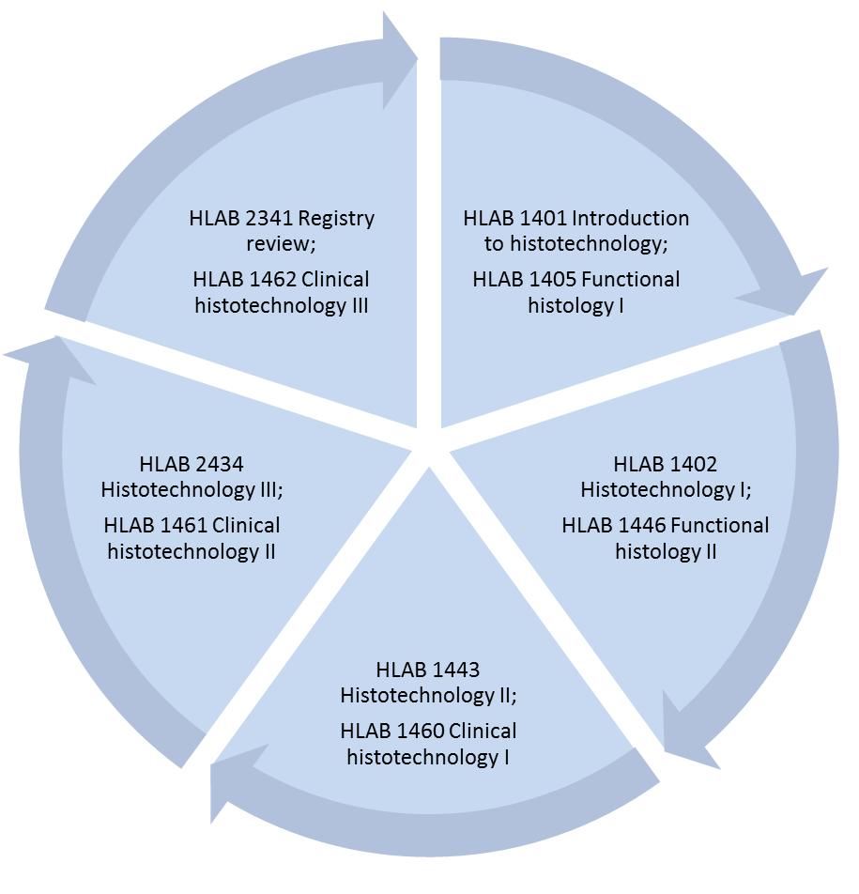
Curriculum
Fall
Spring
Start:
General biology I
General chemistry
Anatomy and physiology I and II
Spring
Fall
Social science
Art/ humanities electives
Summer

Slide 38
Great future with HCC Coleman
https://youtu.be/VQ5_WsDuFJM

Slide 39
Career Advancement

Slide 40
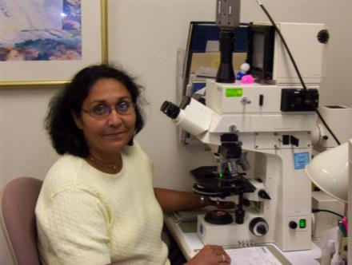
Supervisor / Manager
Senior technologists with an interest in management who coordinate laboratory operations, staffing and finances.

Slide 41
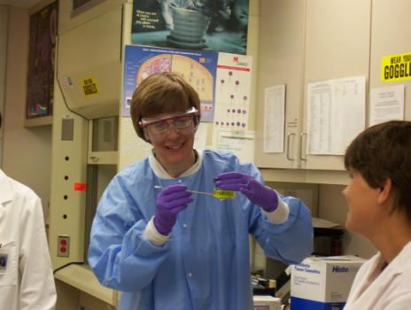
Educator
Senior technologists with an interest in education share their knowledge with the next generation of professionals.

Slide 42
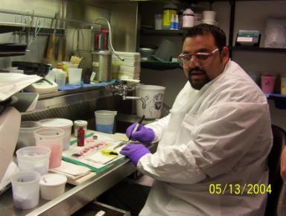
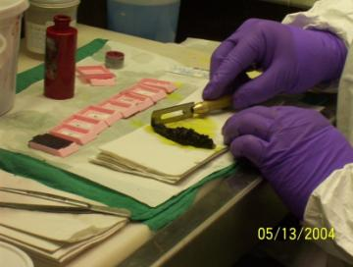
Pathologists’ Assistant
Many are former histotechnologists, medical technologists/clinical laboratory scientists, and cytotechnologists

Slide 43
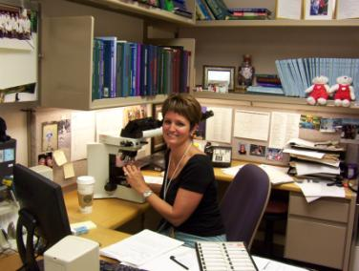
Pathologists
Pathologists (MDs or DOs) function as laboratory medical directors and consultants to a patient’s physician.

Slide 44
Welcome to HCC Histologic Technician Program
See you at Coleman campus!
Thank you.

Slide 45
P-TECH at Hightower: A Student’s Perspective
Presented by:

Slide 46
P-TECH at Hightower: A Parent’s Perspective
Presented by:

Slide 47
The Application Process
Jennifer Chadwick
Early College/P-Tech Coordinator, FBISD

Slide 48
The Partnership with HCC
Athena Walker
Director of P-16 Initiatives, HCC

Slide 49
The Partnership with HCC
Afrah Hassan
Associate Dean, Student Engagement and Success, HCC

Slide 50
Thank you for bring our Guest!
Please stop by the tables in the Commons to interact with P-TECH students, parents, and staff to participate in our Q & A.
Email Us: adrienne.towns@fortbendisd.com or jennifer.chadwick@fortbendisd.com
Follow Us on Twitter: @HHS_PTECH

